Slide 1
CROP PRODUCTION DATA-ANALYSIS

Slide 2
Objective:
dataset provides a huge amount of information on crop production in India ranging
from several years. Based on the Information the goal would be to predict crop
production and find important insights highlighting key indicators and metrics that
influence the crop production.
Benefits:
⮚Improving crop productivity.
⮚Improving yield stability and disease/pest resistance
⮚Enhancing nutritional content of crops.
⮚Minimizing adverse environmental impacts.
Rebuilding agricultural systems.

Slide 3
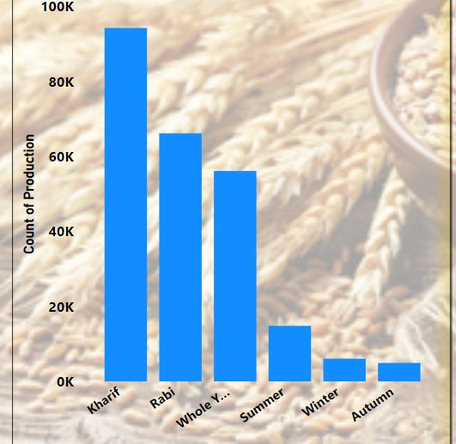
Total Production By Season

Slide 4
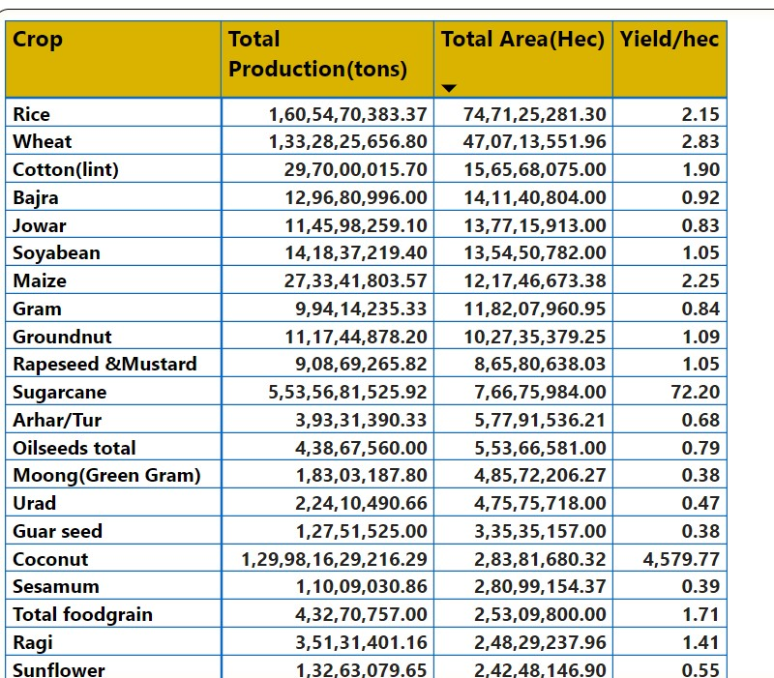
Crop Production
Coconut Production Is very High
Second Productive crop is rice
Wheat is 3rd highest Production.

Slide 5
Dataset
Data Sharing Agreement :
⮚crop production Xlxs.
⮚Length of date stamp(8 digits)
⮚Length of time stamp(6 digits)
⮚Number of Columns
⮚Column names
⮚Column data type

Slide 6
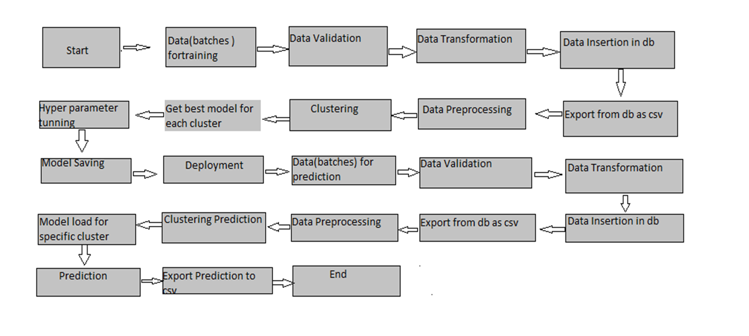
Architecture

Slide 7
Data Validation and Data Transformation :
Data Type Check. A data type check confirms that the data entered has the correct data type.
Code Check. A code check ensures that a field is selected from a valid list of values or follows certain formatting rules. ...
Range Check. ...
Format Check. ...
Consistency Check. ...
Uniqueness Check.

Slide 8
Data Insertion in Power BI:
⮚Data creation :- Go to the get data and add the excel file name crop Production and load in power query.
⮚Insertion of file and transform - All the file in excel sheet load and transform in power query and clean this file through power queries and load the data in power bi desktop.

Slide 9
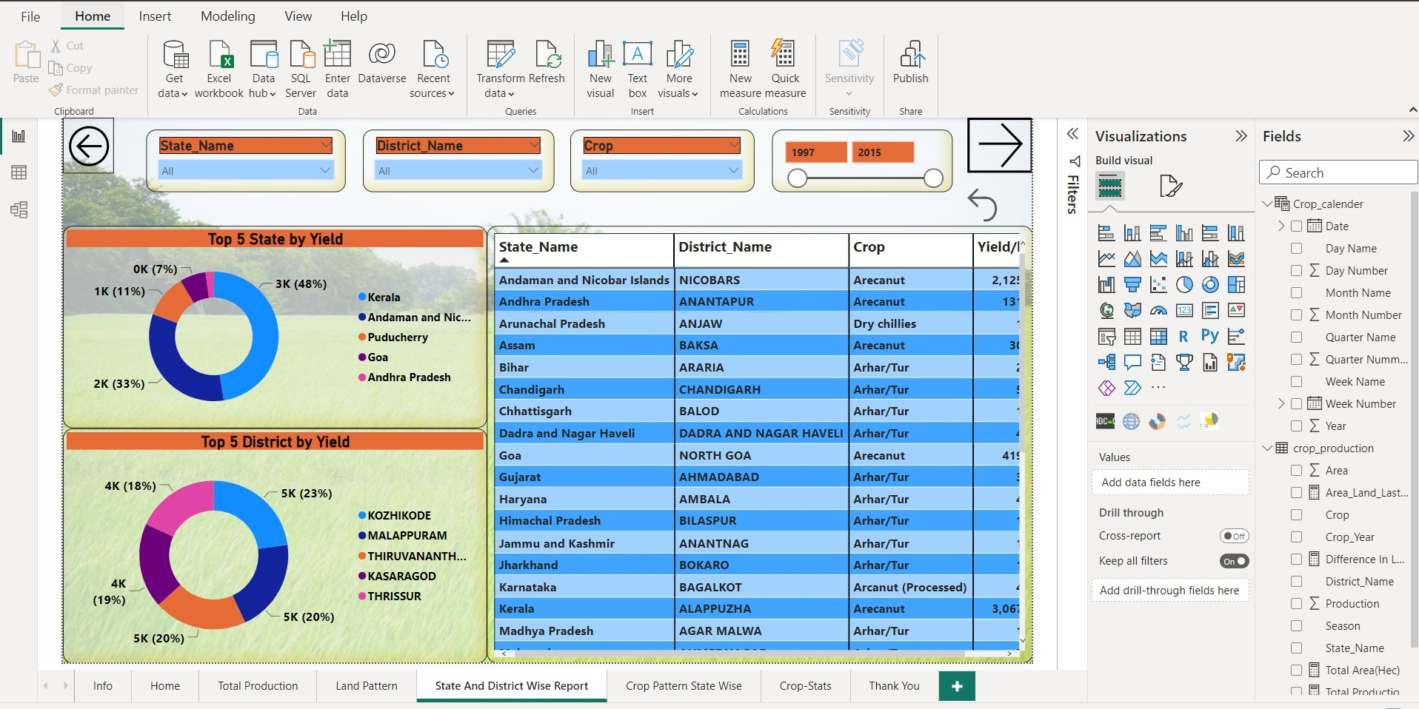

Slide 10
Prediction:
crop models
artificial intelligence
deep learning and machine learning
big data
database of IoT
remote sensing
data fusion
Interseason forecast
sustainable crop production (prediction of water and nutrient deficiencies)
yield influencing variables

